Slide 1

WIPRO NGA Program – Java Full Stack 25VID1947
WIPRO NGA Program – Java Full Stack 25VID1947
WIPRO NGA TRAINING - Java Full Stack 25VID1947
Capstone Project Presentation - 29th August 2025
Project Title - Library Management System
Presented By - Albeena Tasleem
ID - 31288

Slide 2

INTRODUCTION
Library management System is a full-stack project designed to borrow/ return books online.
🔹 Backend – Spring Boot with SQL database for reliable data management
🔹 Frontend – Angular for a dynamic and user-friendly interface
🔹 Containerization – Docker & Docker Compose for portable environments
🔹 Deployment – Kubernetes (Minikube) for scalable orchestration.

Slide 3
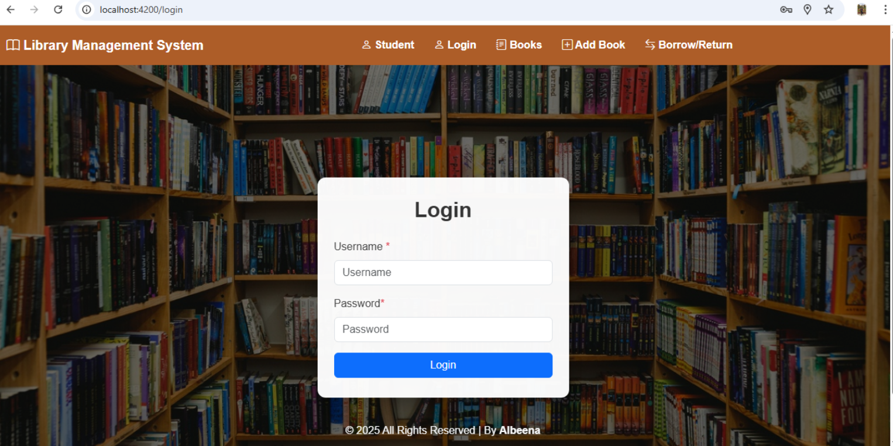
Frontend

Slide 4
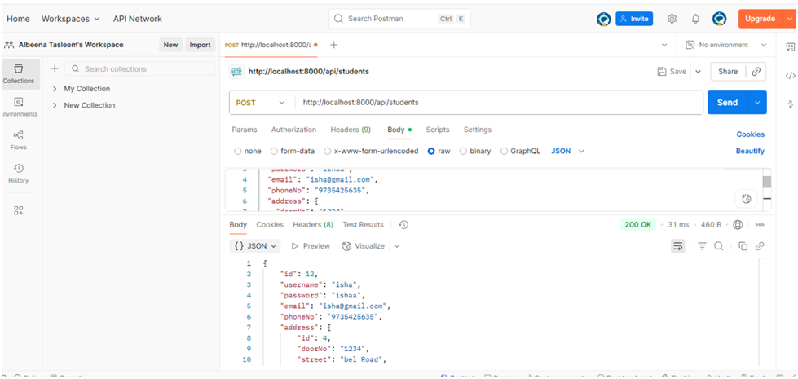
Testing in Postman
Student Testing:
1) Adding student values with address

Slide 5
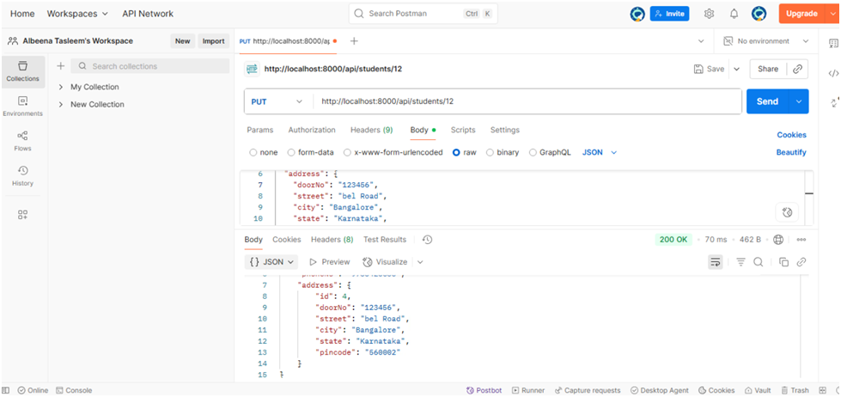
2) Updating the doorNo in the address

Slide 6
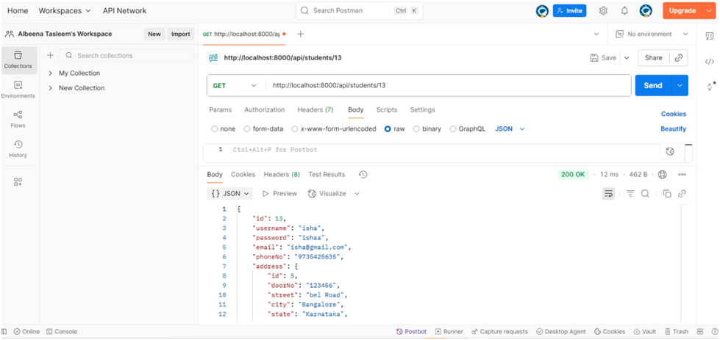
3) Get the details by ID

Slide 7
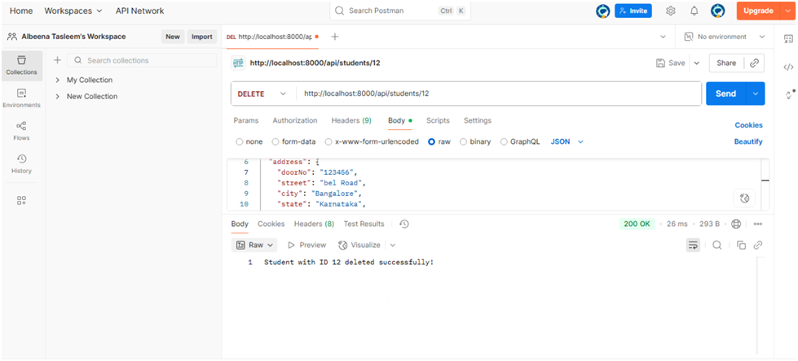
4) Deleting the student details with studentID

Slide 8
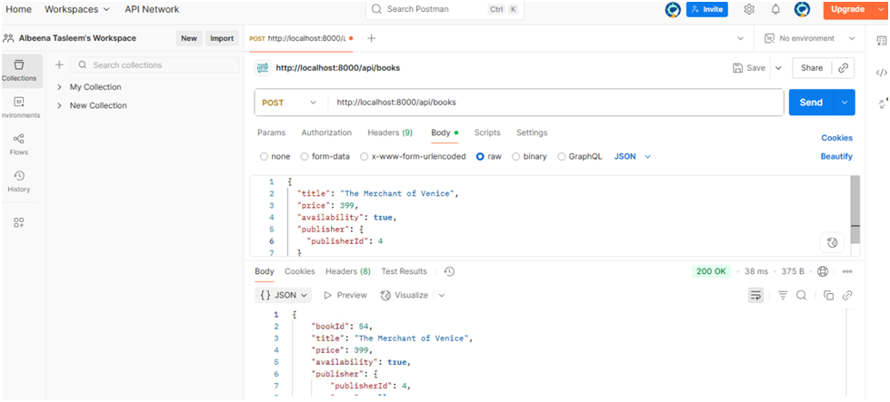
Books Testing:
1) Adding book details with publisher ID

Slide 9
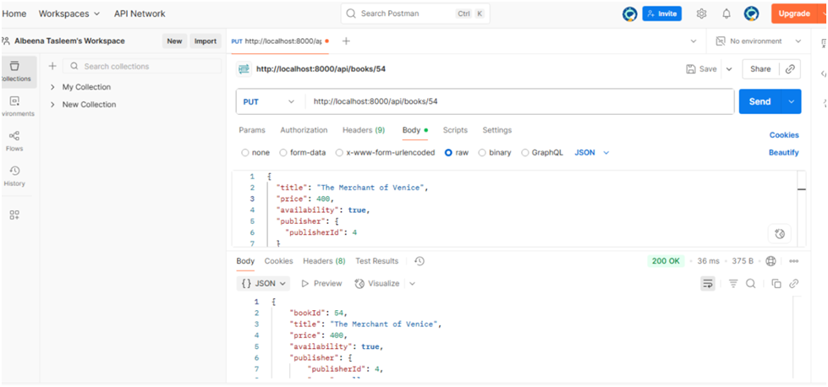
2) Updating the price in the book

Slide 10
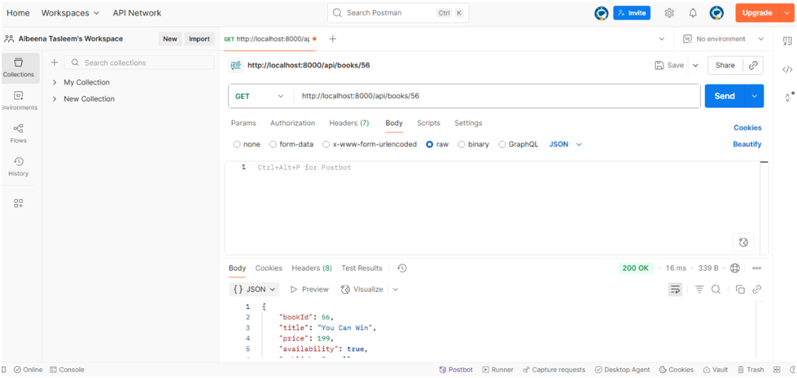
3) Get the details by bookID

Slide 11
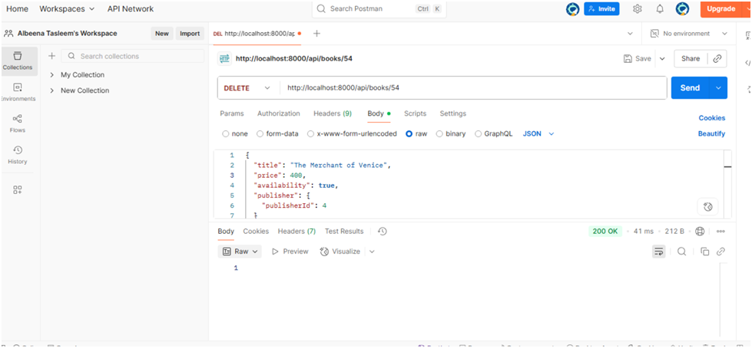
4) Deleting the book details with book ID

Slide 12
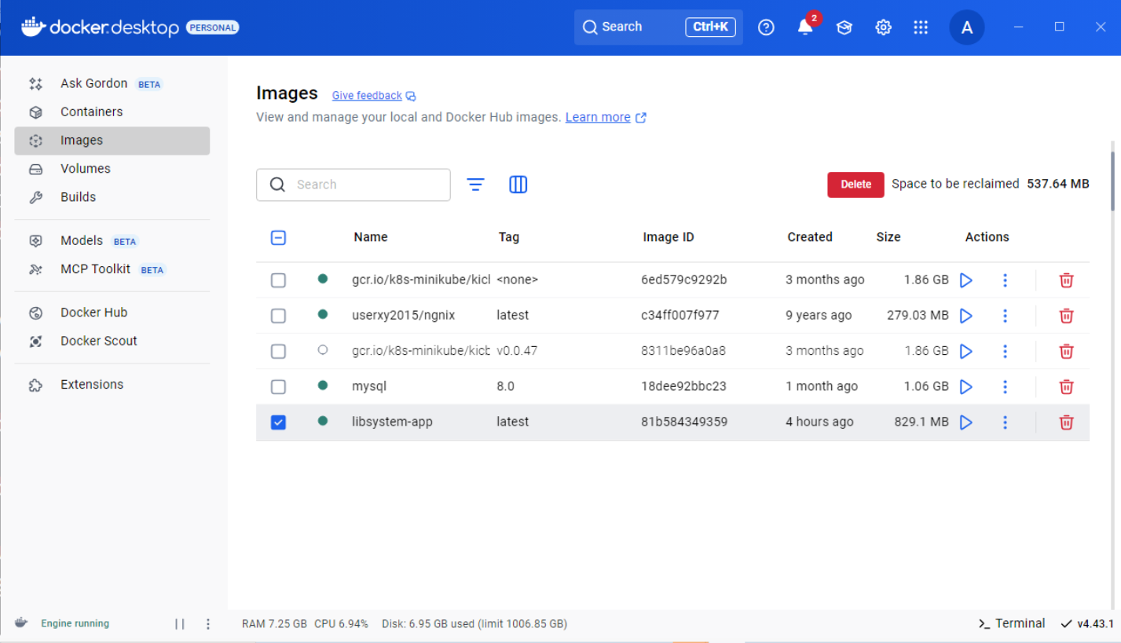
Docker Image

Slide 13
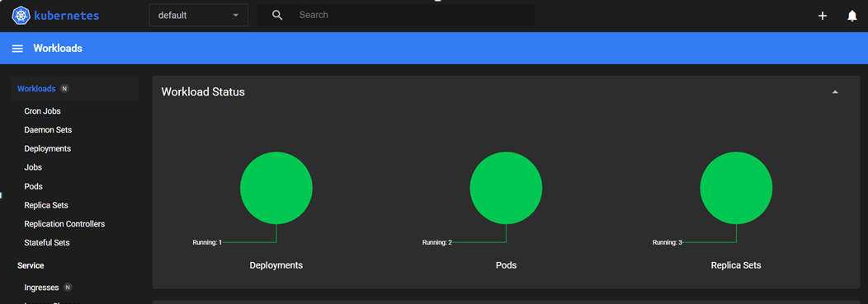
Minikube Dashboard

Slide 14
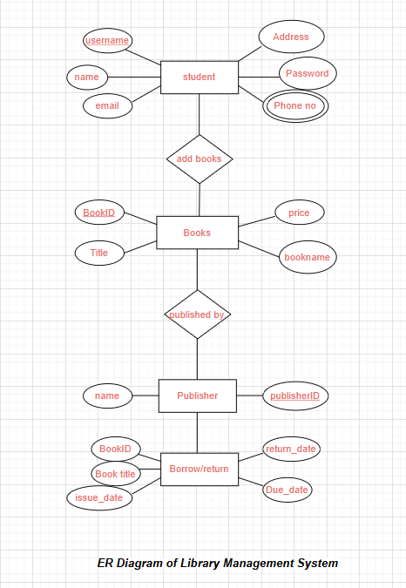
ER Diagram

